Slide 1
Consumer research perspectives
Investments and consumer vulnerability
Leslie Sopp, Chief of Market Research, FCA
The Investment Network 29/06/2018

Slide 2

Coverage
How do different types of consumers work with the investments market, and where are the vulnerabilities?
Exploring FCA and other data resources, incl:
Financial Lives research study
Vulnerability research
Approach to Consumers
Retail Investment Sector View
Money Advice Service: Fin Cap Survey
Not the FCA’s Investment Platforms market research, nor Asset management consumer research

Slide 3
Focus & Limitations
Research and insight – a summary of some elements of our research and data resources
Not a discourse or discussion regarding the FCA’s policy or supervisory approaches or issues

Slide 4
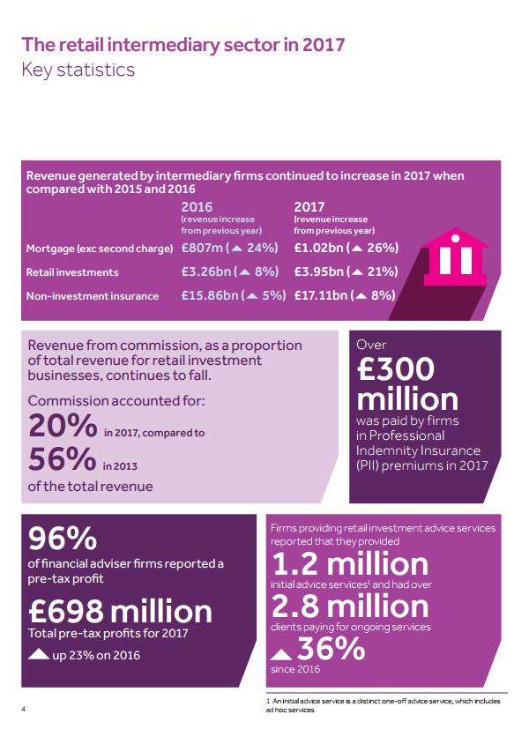

Slide 5





44.5 million
6.5million
15 million
3.2 million
Notes:
44.5 million people have cash savings (87%)
6.5 million have no cash savings (13%)
15 million hold investments (29%)
3.2 million people sought financial advice 2016 (FAMR baseline)

Slide 6



29%
of these
55%
44%
Key stats
Any investment product (excl pensions, investment property or other real investments, such as wine, art, jewellery)
Higher than population incidence
Chart shows % of those holding investments, in each age group, based on 29% of all age groups who have investment products

Slide 7
Investments & Pensions
+4%
-10%
+4%
+1%
Coloured ring base: those with investments
Outer numerals are the incidence difference (+/-) compared with the overall population

Slide 8
Investments & Pensions
-2%
-19%
+4%
+5%
+1%
Coloured ring base: those with investments
Outer numerals are the incidence difference (+/-) compared with the overall population

Slide 9
Key features
Those with investments are more likely to:
Have a total household income of >£50,000
Be more confident managing money
Be more knowledgeable about financial matters
More likely to think of themselves as ‘savvy’ consumers
Credit commitments far less a perceived burden; despite similar levels of debt (12% owe £10K or more- and 6% categorised as over-indebted cf 14%)

Slide 11
Definitions. In difficulty= credit debt/bill repayments missed in 3 or more of the last 6 months; Surviving= bill repayments are a heavy burden / no investable assets / low financial shock management ability; Financially resilient= none of the other conditions apply

Slide 12

Financial Capability Survey 2015
Of those who had ‘investments / stocks & shares’
  93% correctly read a bank statement
  90% correctly answered a ? on inflation
  87% correctly answered a question on interest
Of those who had used a financial adviser in the last year
  91% correctly read a bank statement
  81% correctly answered a ? on inflation
  83% correctly answered a question on interest
Notes:
12%
6%
Compared with 29% FL any investment product

Slide 13
Financial Capability Survey 2015
Of those who did not have ‘investments / stocks & shares’:
  76% correctly read a bank statement
  56% correctly answered a ? on inflation
  61% correctly answered a question on interest
Of those who hadn’t used a financial adviser in the last year:
  76% correctly read a bank statement
  59% correctly answered a ? on inflation
  63% correctly answered a question on interest
Notes:
12%
6%
Compared with 29% FL any investment product

Slide 14
Regulated advice
17% of investors have had regulated advice in the 12 months previous to the survey (2016) – three times the UK population overall
52% of investors were not advised in previous 12 months and may benefit
  As more of this group have used an advisor at some stage in the past
50% of those having regulated advice did so from an IFA. 5% used automated online advice

Slide 15
Issues and opportunities
Information and communication
Consumer inertia and personal responsibility
Duty of care
Product purchasing and knowledge
Platform engagement
Pricing
Transparency
Quality and channel of engagement
Customer centricity and insight
Managing vulnerability

Slide 16

Vulnerability
One of the biggest challenges for firms was found to be striking a balance between enabling / empowering, and safeguarding / protecting consumers, and the research evidenced that many providers particularly struggle with the former.
Furthermore, the research found that problematic firm behaviour can often cause or exacerbate the financial issues experienced by vulnerable consumers.
These practices can be classified into five key types:
• The failure to provide clear explanations and easily understood communication
• Inappropriate and predatory sales behaviours
• Technological innovation can empower vulnerable consumers but it also leads to digital exclusion and ‘work arounds’
• Poor front-line interaction
• Rigid product design and service structures

Slide 17
Vulnerability
Many financial products, services and systems are currently not designed to respond to inevitable vulnerability
• A combination of vulnerability and firm behaviour can and does result in negative and detrimental outcomes for consumers
• Many of these negative outcomes appear to be unintentional and should, therefore, be avoidable
• However, vulnerable customers are at increased risk of firm exploitation

Slide 18
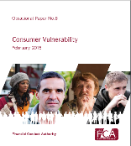
Vulnerability
Everyone can (and most people do) experience vulnerability at some point in their lives.
Vulnerability is diverse, complex and dynamic – it is often unexpected and unpredictable, and the experience of it changes over time.
Vulnerability can have a range of emotional and practical impacts on individuals, including heightened stress levels, time pressures, lack of perspective, poor decision-making and changing attitudes towards risk-taking.
A vulnerable consumer is someone who, due to their personal circumstances, is especially susceptible to detriment, particularly when a firm is not acting with appropriate levels of care.

Slide 19
Vulnerability
Levels of self-reported life events that could impact on vulnerability were generally lower among the (older) investor population
  Except death of a (close) family member and inheritance
Investment and Pension scams are particularly targeted on the older and wealthier or impacted on those less experienced, well-informed or capable
Also evidence reveals and research indicates that pension freedoms can come at a price to unsuspecting or ill-equipped or poorly informed consumers (or exploitative firm behaviour)

Slide 20
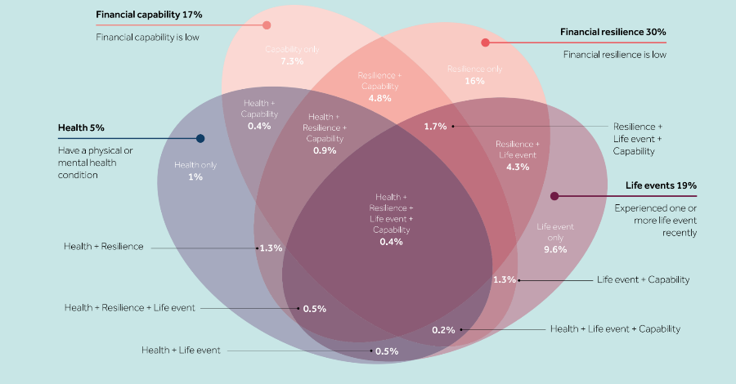
Vulnerability – combined characteristics

Slide 21

Consumer response to firms

Slide 22


Consumer response to advisers
Notes:
The 39% trust masks differences between those who have had regulated financial advice in the 12 months preceding the survey, or not
58% of those who have do trust, but only 19% strongly
– with 21% distrusting, 7% strongly

Slide 23
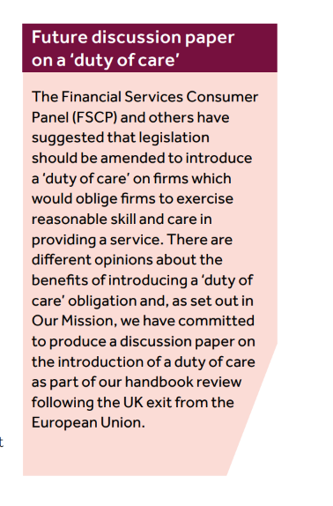
Approach to consumers

Slide 24

FCA Resources
Approach to Consumers:
https://www.fca.org.uk/publication/corporate/our-future-approach-consumers.pdf
Ageing Population:
https://www.fca.org.uk/publications/occasional-papers/ageing-population-financial-services
Vulnerability:
https://www.fca.org.uk/publications/occasional-papers/occasional-paper-no-8-consumer-vulnerability
Access:
https://www.fca.org.uk/publications/occasional-papers/occasional-paper-no-17-access-financial-services-uk
Financial Lives:
https://www.fca.org.uk/publication/research/financial-lives-survey-2017.pdf

Slide 25


Questions and discussion

Slide 26

Leslie Sopp, Chief Of Market Research
T: 0207 066 5076
E: leslie.sopp@fca.org.uk
12 Endeavour Square
Stratford
London
E20 IJN

